Slide 1
Unveil the obscure network of company and location data using smart algorithms
Team 2: Stephanie, Ojasvi Prakhar, Marco, Susann

Slide 2
TABLE OF CONTENTS
Overview
Outlook Sprint 2
Problem characterisation
Method selection
Description of options
Hybrid implementation of methods
Our ways to go and evaluation for solutions
Internal validity & Completeness, External validity, Limitations
Proof of concept
Solution: Cement Industry
App
Added Value for Swiss Re
Added value of the solution
Outlook

Slide 3
OVERVIEW
01

Slide 4
PROBLEM CHARACTERISATION SPRINT 1 & 2
Defining features in which a company and its locations (e.g. factories, warehouses, sales points) can be interlinked.
Identifying free or affordable source of information, where data supports applying an ontology to the actual companies and buildings.
Select methodologies for the implementation with validation and feasibility

Slide 5
End Sprint 1 & Feedback received
Our goals for sprint 2 are:
Collect company information from platforms like ImportYeti and DnB using scraping tools
Implement the Vision API to extract company names from Google Street View and Google Earth and other sources
Build a searchable ontology for Swiss Re to abstract the API calls and matching processes in the background
Perform text normalization exercise to match the company address to a single address irrespective of spelling.
Our goals for sprint 2 are:
Semantic search
Handle semantic biases
Satellite image (sat) processing present new solution
Scalable, repeatable, implementable
Cost awareness
Notes:
Commenting feedback provided
20& -> 80 approach

Slide 6
Sprint 2 xxxxx
We tested our solution for several industries (cement, supermarket)
Enhanced our solutions to a scalable approach
New data sources (costs, remote areas) to fill gaps
Notes:
Commenting feedback provided
20& -> 80 approach

Slide 7
METHODS
02

Slide 8
Description of Methods
1. NLP Ontology: DNB & DUNS; Panama, Paradise and Pandora papers for offshore and virtual address, or the Global cement directory report
2. Top View: Semantic image search using, e.g. CLIP (from OpenAI) applied to sat and terrain view repos of North America, Africa etc.
a) Library used: CLIP Notebook
b) Library Used: Google MUM Multi-Modal T5
c) Library Used: CV modals on TF or Sagemaker...
3. Sat View: Text Extraction of company names from the buildings or building entrances signs, potentially for inclined sat view.
(Cement factory company_detection from image)
Crowdsourcing the company annotations:
4. Google PlusCODES, SearchOn: coordinate numbering system for buildings
5. E.g. via Nantic’s now open sourced lightning dev environment, or similar to Google Captchas...

Slide 9
SPRINT 2 HYBRID OF METHODS (1-5)
Searchable Ontology
Analysis from top view
Analysis ground view
An ontology built with a scraper that Swiss Re can use for searching for a particular company within the database.
Applying cutting-edge object detection methods to satellite, drone, airplane map APIs, or with help of Google Plus Code
Combining Natural Language Processing (NLP) text extraction with Computer Vision (CV) methods to Streetview or
Geological data

Slide 10
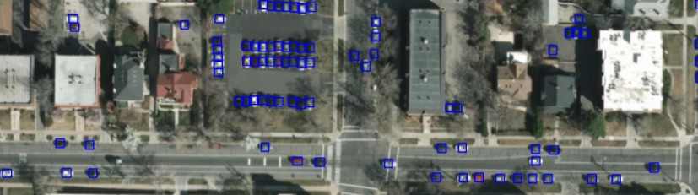
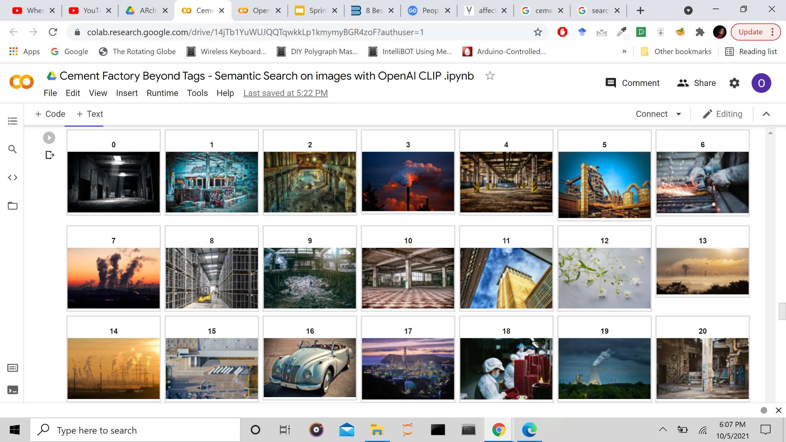

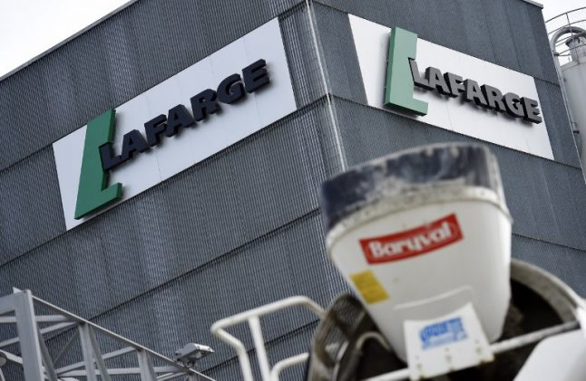
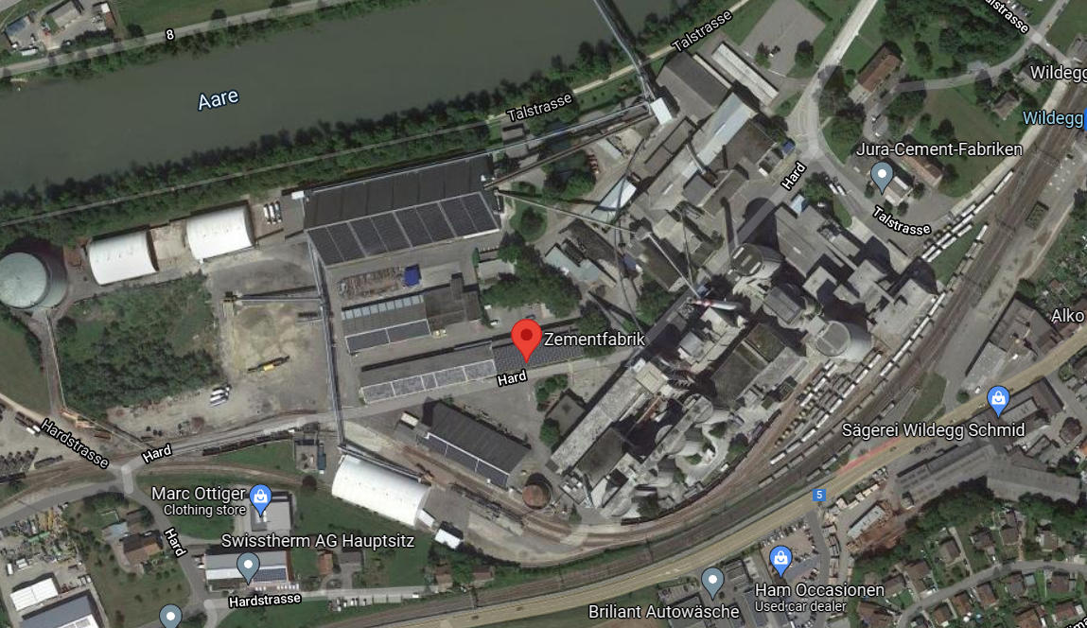
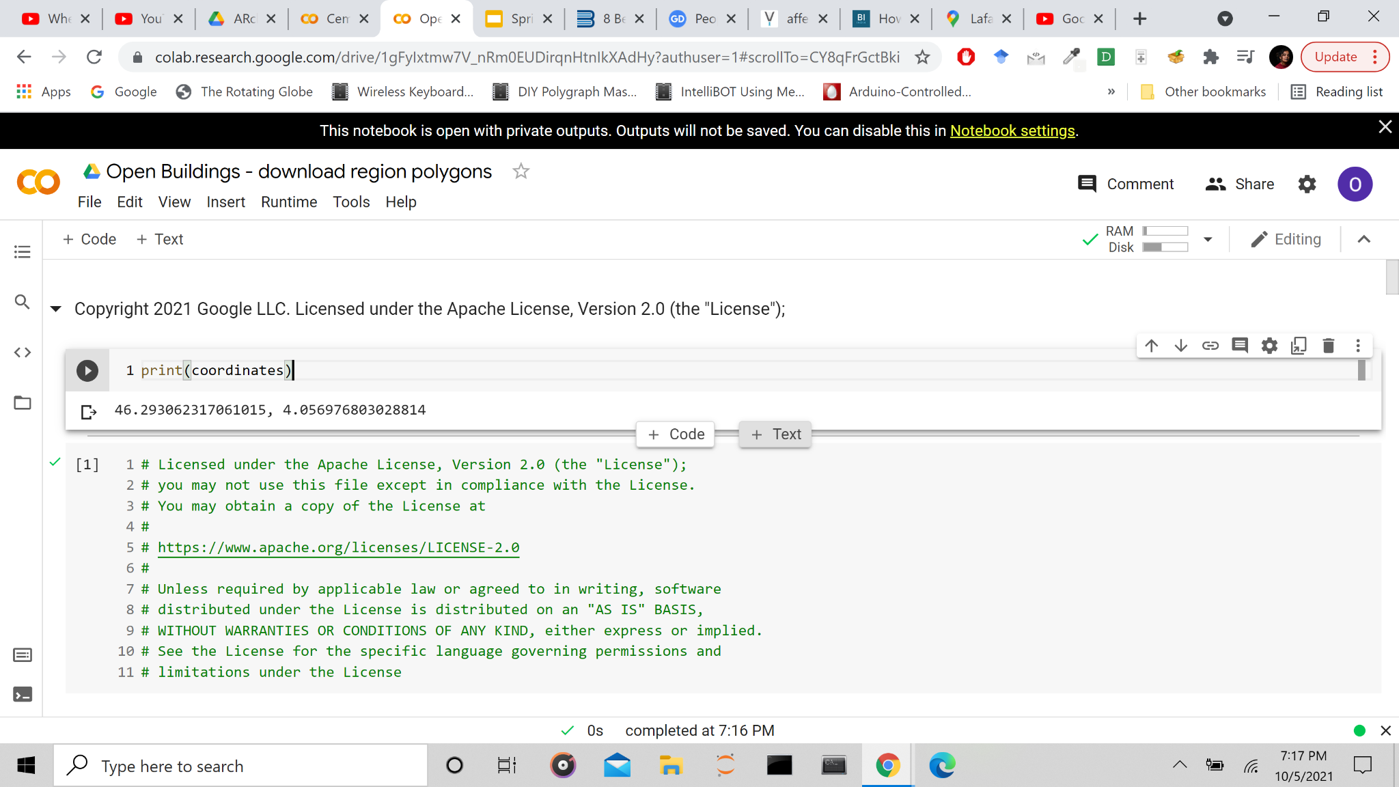
Lafarge Holcim
2. YOLO Object detection in satellite images
1. Text Search
3. CLIP Semantic Image Search
WHAT
WHERE
WHAT
WHERE
4. Text OR Logo Detection
6. Street from Google Maps
LAFARGE
5. Geolocation Coordinates from GEE

Slide 11
OUR Ways for implementation
White-Label Path
Optional preprocessing: YOLOR or similar algorithm to identify buildings and sites in satellite visual and terrain images for higher accuracy, or via transfer learning by feeding the bounding boxes to CLIP.
Already done and uploaded for over 1bn buildings.
Top view: CLIP notebook to search through the sat images with buildings in it. (Crosscheck and subtract the ones already listed in the NLP Ontology)
Ground view: Text and/or logo detection
Geolocation: Google Earth Engine (GEE) script for coordinates to street address or to Plus Codes
Optional addition: Address normalization fuzzy logic tool
Happy Path
Top View: Google MUM (combines YOLOR in TF2 notebook, or CLIP notebook)
Ground view: Text and/or logo detection
Geolocation: GEE script for coordinates to street address or to Plus Codes
Optional addition: Benefits of extension to other Swiss Re departments and use cases
Notes:
ADD notebook names for solution

Slide 12
OUR Ways for implementation
White-Label Path (5 Steps)
Step 1 white label phase:
T2 notebook for any object detection algorithm implementation from Tenserflow Hub
Open buildings georeferencing notebook as example for the 2/3 of the continent of Africa for building detection and coordinates extraction as well as Github repos for USA&Canada
Step 2 white label phase CLIP: notebook for identifying potential company candidates
Step 3. white label phase CLIP:
AWS cement factory detection notebook for uniquely identifying llanguage and company from text on satellite or streetview images on company buildings, entrance or outdoor objects, such as branded trucks or containers on ships or harbors.
Step 4: Open Buildings - download region polygons
https://code.earthengine.google.com/?scriptPath=Examples:Datasets/GOOGLE_Research_open-buildings_v1_polygons
Step 5 White label path:
Prakhar
Happy Path
Top View: Google MUM -
Ground view: Text and/or logo detection
Geolocation: GEE script for coordinates to street address or to Plus Codes
Optional addition: Benefits of extension to other Swiss Re departments and use cases
Notes:
ADD notebook names for solution

Slide 13
Our Way to Go: EVALUATION of Solutions
03

Slide 14
ASSUMPTIONS
It is possible to extract the company names from satellite images, and each factory/location having a sign outside. This is not referring to virtual “postbox” addresses and property shared addresses with no physical office (tax paradise), which we cover instead with DNB and the different report sources
Google MUM search will be made available, can do a lot of what satellite view with YOLO and/or CLIP can, but at almost no cost and no time to develop. “The best of both worlds”
Street view shows limitations in countries like Vietnam and China, and so if a company has facilities in these countries they will be likely missed and reinsurance claims would be inaccurate, e.g. China is dependent on Swiss Re local solutions.
Text extraction cannot only be applied to Google maps content as we did, but in the same way actually be used across Swiss Re to automate, speedup, scale, lower the costs and prevent fraud for any document processing of images or texts and multilingually.
Semantic bias will be handled with Google MUM combining context and image search in one database, so the content is unique.
DNB database provided more than 3000 entries for Lafarge & Holcim, covering more than 80% of all entries. Another industry supermarket was tested as well.
The hybrid solution is covering the whole cement industry and more.
Google Plus code is covering majority of countries in the world
Notes:
Avoiding China/
Holcim / Lafarge how many hints
Check for other industries & language
Google MUM

Slide 15
WHITE-LABEL PATH - CLIP (Contrastive Language Image Pre-Training) with Text extraction
Limitations | Positives
It performs well on recognising common objects, less so on more abstract and systematic tasks. Zero-shot CLIP has lower accuracy compared to task-specific models on very fine-grained classification. | Highly universal for features, domains and objects. Allows for text and image search, and even data formats like video for historic analysis. Trained and working on sat images too.
Poorer generalisation to images not covered in its pre-training dataset. | Flexible and general - more so than existing ImageNet models
More expensive than the Happy Path as we would need to make the database of companies. | Inference is open sourced and many extensions, alternatives and applications to other domains.
Slower run-time and longer to develop due to YOLOR and CLIP being separate steps. | Can be used in a zero-shot manner.
Notes:
MAILBOX?
Because they learn a wide range of visual concepts directly from natural language, CLIP models are significantly more flexible and general than existing ImageNet models. We find they are able to zero-shot perform many different tasks. To validate this we have measured CLIP’s zero-shot performance on over 30 different datasets including tasks such as fine-grained object classification, geo-localization, action recognition in videos, and OCR.[2] In particular, learning OCR is an example of an exciting behavior that does not occur in standard ImageNet models. Above, we visualize a random non-cherry picked prediction from each zero-shot classifier.
This finding is also reflected on a standard representation learning evaluation using linear probes. The best CLIP model outperforms the best publicly available ImageNet model, the Noisy Student EfficientNet-L2,23 on 20 out of 26 different transfer datasets we tested.

Slide 16
HAPPY PATH: Google Multitask Unified Model (MUM) with Textextraction
Internal validity, Completeness & External validity, Limitations
Limitations | Positives
Edge cases like company names on ads, could misidentify buildings (Can overcome this with the validation on Streetview in the following step) | Automating, able to combine both YOLOR and CLIP AI. GoogleMUM is a more comprehensive Google Places, classification and normalization already done.
Not released publicly yet, but announced for the coming months. | Much faster and much cheaper, and the backend T5 is trained on 75 languages already. Doesn’t require downloading images.
Cannot cover virtual entities (Swiss Re internal legacy system might cover part of it) | More likely to work where centrally collected and processed data on building ownership is ‘less than fully reliable’
Notes:
Because they learn a wide range of visual concepts directly from natural language, CLIP models are significantly more flexible and general than existing ImageNet models. We find they are able to zero-shot perform many different tasks. To validate this we have measured CLIP’s zero-shot performance on over 30 different datasets including tasks such as fine-grained object classification, geo-localization, action recognition in videos, and OCR.[2] In particular, learning OCR is an example of an exciting behavior that does not occur in standard ImageNet models. Above, we visualize a random non-cherry picked prediction from each zero-shot classifier.
This finding is also reflected on a standard representation learning evaluation using linear probes. The best CLIP model outperforms the best publicly available ImageNet model, the Noisy Student EfficientNet-L2,23 on 20 out of 26 different transfer datasets we tested.

Slide 17
PROOF OF CONCEPT
04

Slide 18
Price Analysis Google & AWS
Prices list GCP and AWS:
https://cloud.google.com/maps-platform/pricing/sheet, https://aws.amazon.com/rekognition/pricing/
Suggestion Google Maps and locally Streetview for text extraction and CLIP in the final deliverables: 100k satellite pictures, 28k Streetview panoramas free a month, CLIP inference open source.
Scaling further potentially Google Earth or Sagemaker API call costs, but almost only one time or could be timed once a year/month for update of new buildings for classification/geolocation.
Cost of the inference API for instance Rekognition or Sagemaker for the sat view at about 100k images estimate for the whole globe coverage at such height, would also be about 100$ once a month or once a year for construction or office moving updates according to this.
For Streetview globally also more as more panos, but this text detection which is multilingual could also be run locally in a free model, so it is only the computing and storage cost then.
Maybe storage and its costs not necessary, if Google Earth Engine or MUM as in the happy path allow that like in the other script and just storing the text strings or matched text strings.

Slide 19
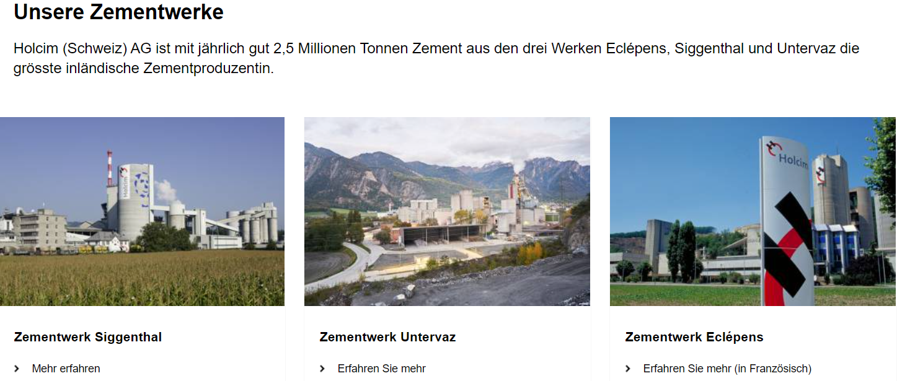
CEMENT INDUSTRY
Gravel site, industrial chimney and outdoor conveyor belts over the river, each with high confidence detected on satellite photo and terrain views. In combination and close to an urban or industrial area, railway and main street access, water source nearby, several warehouses and silo very likely pointing to a cement factory.
Conveyor Belt, 65%
YOLT for bounding boxes on satellite and terrain view
Then CLIP for identification
Rekognition on Streetview with zoom:
Holcim, 98%
GEE:
Talstrasse 13, 5103 Möriken-Wildegg, Switzerland
Address-norm:
Talstr. 13, 5103 Möriken-Wildegg, Switzerland
Gravel Terrain, 80%
Industrial Chimney, 84%

Slide 20
NOTEBOOKS & VIDEO GOOGLE
DEMO

Slide 21
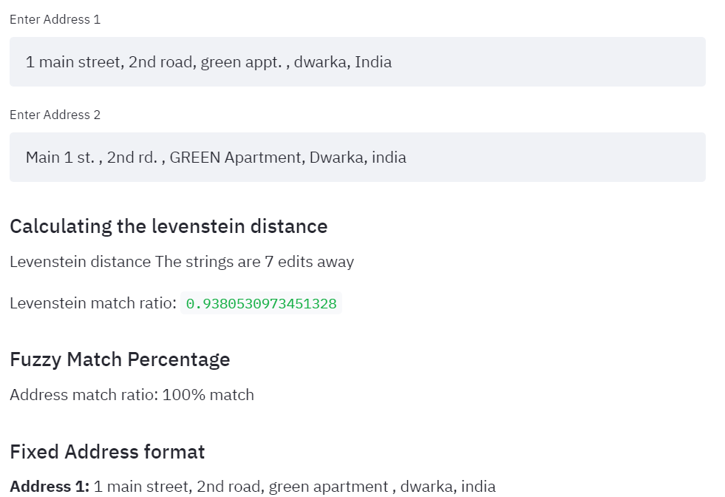
Text Normalization App
Google Plus Codes offers standardization/normalisation from coordinates
We built a web app to solve the secondary problem of address matching
It uses concepts of fuzzy logic address matching and the Levenshtein as distance metric for normalization.
This can be used as a stand-alone app and is also used in our search API to match the final addresses to the correct location together with 1000 star Python library for address cleaning.
Link to App: https://fuzzy-address.herokuapp.com/

Slide 22
ADDED VALUE FOR SWISS RE
05

Slide 23
Added value of our solution (Hybrid of methods)
NLP Ontology
Computer Vision Extension
Very complete, global
Fast, readily available
Not expensive
Automatic update alerts
Fraud prevention
Better risk assessment
Complement the missing entries globally
Images updated daily
Independent analysis for further fraud prevention
Unmatched risk assessment
Automatic text extraction for Image or text documents across the company

Slide 24
OUTLOOK other technologies / Sources
SWITCH Transformer 2021 and WuDAO 2.0 for China 2021,
1 full Magnitude bigger than CLIP/T5 from 2020
Google MUM more multilingual, with Google Lens on desktop
Google PlusCODES Initiative, since September 2021 with app
Crowdsourcing the company annotations in a fun way like in a game challenge or for security, for instance Google Captcha or via the now open-sourced Lightship dev by Nantic
Higher resolution sat or drone networks once Starlink and competitors add Imagery, and expansion of Streetviews
Speedup and extend Multi-Modality to Audio and Video for further matches through historic sat analysis or even real-time updates

Slide 25
THANKS!
Do you have any questions?
Team 2

Slide 26
BACK UP

Slide 27
SCALED & ACCESSIBLE DATA SOURCES
Company information: Dun & Bradstreet, Importyeti.com, Company websites, Chambers of commerce
(Unique DUNS number in paid version of DnB allows overcoming same naming)
Satellite image view: WorldView3/4-Satellite (20+ spectra), Google Maps, Yelp, NASA World Wind (LandSat 7)
Satellite terrain view: Google Earth Engine, EoFactory AI
Ground view: Google Street View

Slide 28
SELECTION OF COMPANY / COUNTRY
At least 2 way footprints inside model fourastie
Worldwide availability and several locations
Listed at stock exchange to have accessible data
Company ensures challenges with the name (e.g. through M&A transactions)
Industry selected ensures images for satellites can be differentiated
Focus on sustainability (“Green cement industry) and have Importance for the infrastructure of a country
The biggest supplier worldwide
Cement industry: 1st producer is China, 2nd India
Exclusion of China for sample set due to availability of data
Sample: LaFarge Holcim
M&A 2014 Swiss company, brand in India Ambuja Cement Limited
Primary Sector: Mining of gravel and cement
Secondary Sector: Production of concrete
Countries: Switzerland, Colombia, India
SWISS Re Team please advise

Slide 29
QUICK RUN-THROUGH OF STEPS PERFORMED:
Visualization, Outline:
Submit ppt.: Complete presentation with notebooks and link resources
Virtual presentation: Slides 10mins, Demo in jupyter or Colab 4mins, Prakhar`s normalization, fuzzy logic 1min
In detail:
Susann and Stephanie: Presentation
Marco: Outline the methods and notebooks
PPt: One slide of Prakhar`s normalization tool (done)
Oj: Graph of data or business flow of our solution
Top-view: YOLOR identify buildings in satellite images
Top-view: CLIP notebook to search through the sat images with buildings in it
Ground-View: Text AND/OR logo detection
Geolocation as to coordinates
Street from GEE
Address normalization

Slide 30
Searchable Ontology: Analysis
The business address information can be extracted from the Dun&Bradstreet with manufacturers, subsidiaries etc., or also from ImportYeti website with a web scraper or can merge it with a Selenium script. Then can plot these locations on a map or a heat-map to visualise the locations or the supply.
Strength
Easily Searchable and less coding required
NLP methods allow for hierarchy and relationships retrieval
Can be hosted on the cloud with differential access
Faster searching because the data is already loaded
Highly scaled, works globally
Weakness
Maintaining a database can be a bit less user-friendly
Companies with the same name or lots of name changes
Can take up a lot of space to store over a period of time

Slide 31
Analysis from Top View
With object identification algorithms, such as recent YOLT or YOLOR versions, CNN and transformer-based solutions applied to satellite images or drone photographs in various spectra we can also provide locations of factories or tech parks that have a fence or wall around, and through this multiple buildings or offices of a company inside it. Similarly, for other domains, such as mining, power networks or factories using transfer learning applied to foundational models, or self-learning.
Strength
Allows finding buildings and objects not registered or covered in any database
Doesn’t take up a lot of space since it doesn’t store data, unless specifically desired
Updated daily, works globally
Provides further visual and more spectral data for other risk analyses too
Weakness
Takes more time to build and more code or scripts
Can be slower because API or inference may run each time
Limited to buildings and objects or industries that can be uniquely identified or attributed

Slide 32
Analysis Ground View
Can perform CV on Google Earth/Street View together with NLP cross-modally via models we have built using for instance the Sagemaker APIs to extract company names from the building names or entrance inscriptions to match and complete the list of buildings that may be away from others or detached.
Strength
Our modern computer vision text extraction methods are very precise
More extensive and accurate than from satellite view
Very detailed, allowing for further risk factor analyses
Works for almost all industrial areas
Weakness
Limited to where street image data or other image data is available
Less frequently updated
Not showing company relationships

Slide 33
Address Text Normalisation
(Secondary Problem) prahkar update and visualize
For the secondary problem of normalising address names, we can use fuzzy logic for address matching with the Levenshtein as distance metric for a probability score for how close they match, and similar address matching methods, such as the Swiss Re database and new web APIs. The accuracy can also be enhanced further via modern NLP or bi-modal pattern matching methods.
This can be combined with the Google Maps or Bing APIs to find the corresponding location and coordinates. The coordinates can then be stored in a database or ontology. This process can be made as a real-time service using Python scripts.

Slide 34
Examples
Lafarge Holcim Switzerland and surrounding buildings in Untervaz (Cement & Baustoffhof)
Other industry Supermarket

Slide 35
INTERNAL VALIDITY
Do you know what helps to make your point clear? Lists like this: one
They’re simple
You can organize your ideas clearly
You’ll never forget to buy milk!
And the most important thing: the audience won’t miss the point of your presentation

Slide 36
EXTERNAL VALIDITY
Do you know what helps to make your point clear? Lists like this: one
They’re simple
You can organize your ideas clearly
You’ll never forget to buy milk!
And the most important thing: the audience won’t miss the point of your presentation

Slide 37
LIMITATIONS IDENTIFIED
Do you know what helps to make your point clear? Lists like this: one
They’re simple
You can organize your ideas clearly
You’ll never forget to buy milk!
And the most important thing: the audience won’t miss the point of your presentation

Slide 38
Roadmap
DAY 1
Week 2
Week 1
20.09.21 09:00 am CET
Ideation, built out the Use case
Submission & Presentation
Kick Off, Get to Know, Independent Search
Prototyping and testing, presentation creation

Slide 39
A GOOD WAY TO END THE PRESENTATION

